Slide 1

Further Resources
v1.2.0
Copyright © 2015 Chef Software, Inc.

Slide 2
What Do I Do Now?
To learn more you are going to need more practice and more resources. It takes a village and a couple of web servers.
In this module, we will:
Provide you with resources that you can read
Provide you with resources that you can watch
Provide you with resources that you can listen
Provide you with resources that you can attend

Slide 3
The Slides From This Course
https://goo.gl/cExAi1
Provided in PDF format

Slide 4
Documentation
http://docs.chef.io

Slide 5

Learning Chef
A Guide to Configuration Management and Automation

Slide 6
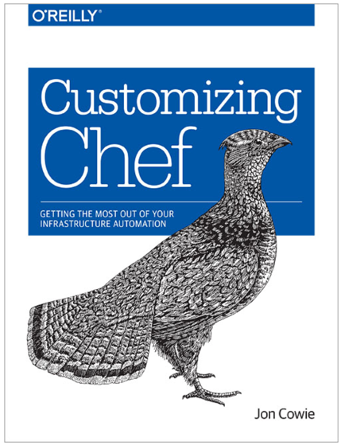
Customizing Chef
Getting the Most Out of Your Infrastructure Automation

Slide 7
Youtube Channel
ChefConf Talks
Training Videos
https://www.youtube.com/user/getchef/playlists

Slide 8

foodfightshow.org
http://foodfightshow.org
Food Fight is a bi-weekly podcast for the Chef community. We bring together the smartest people in the Chef community and the broader DevOps world to discuss the thorniest issues in system administration.

Slide 9

theshipshow.com
http://theshipshow.com The Ship Show is a twice-monthly podcast, featuring discussion on everything from build engineering to devops to release management, plus interviews, new tools and techniques, and reviews.

Slide 10
Chef Developers' IRC Meeting
Join members of the Chef Community in a meeting for Chef Developers where we’ll discuss the future of the Chef project and other things pertinent to the community.
http://irc.freenode.net#chef-hacking
TBD Link bad?

Slide 11
Chef Community Summit
The Chef Community will gather for two days of open space sessions and brainstorm on Chef best practices.
The Chef Community Summit is a facilitated Open Space event. The participants of the summit propose topics, organize an agenda, and discuss and work on the ideas that are most important to the community.
https://www.chef.io/summit

Slide 12
ChefConf
It’s the gathering of hundreds of Chef community members
We get together to learn about the latest and greatest in the industry (both the hows and the whys), as well as exchange ideas, brainstorm solutions, and give hugs, which has become the calling card of the DevOps community, and the Chef community in particular

Slide 13
Discussion
What questions can we answer for you?

